Slide 1

REAL-TIME RIVER WATER QUALITY MONITORING AND CONTROL SYSTEM
UNDER THE GUIDANCE OF:
Mr. K. MURALIDHARAN M.E.,
PROJECT STUDENTS:
SHIRANJEEVI A 2004207
SHARJEEL AMIN 1904111
PRANEETH S 1904101
SANJAY R 1904108
PRAVEEN BHARATHI K 1904102

Slide 2
OBJECTIVE
The main aim of this project is to detect the quality of river water and quantity of pollutants present in water and so that river water quality is monitored and effective measures can be taken accordingly .

Slide 3
NEED FOR THE PROJECT
As per increase in water pollution there is need of controlling pollution in water is finished by monitoring water quality.
Our system consists of various sensors which will compute the standard values of water in real time for effective action and is accurate and only less manpower required.
To collect data from various sensor nodes and send it to cloud by IoT and to measure critical chemical and physical parameters of water.
System must be a low-cost, most efficient as well as processing, sending and viewing data on cloud through web and mobile.

Slide 4
LITERATURE SURVEY
S.No. | TITLE | MODEL / TECHNIQUES USED | MERITS/ DEMERITS | OUTCOMES
1. | Y. Wang, I. W. -H. Ho, Y. Chen, Y. Wang and Y. Lin, "Real-Time Water Quality Monitoring and Estimation in A IoT for Freshwater Biodiversity Conservation," in IEEE Internet of Things Journal, vol. 9, no. 16, pp. 14366-14374, 15 Aug.15, 2022 | Internet of things. | Merits: Prediction error is less than 0.2mg/L. Demerit: Limited sensors only available in market. | Monitor water quality for conserving freshwater biodiversity.
2. | S. Chopade , H. P. Gupta, R. Mishra, P. Kumari and T. Dutta, "An Energy-Efficient River Water Pollution Monitoring System in Internet of Things," in IEEE Transactions on Green Communications and Networking, vol. 5, no. 2, pp. 693-702, June 2021. | Internet of things. | Merits: Accuracy is higher. Demerit: Less reliable | Estimate and transfer pollution data from river consuming minimum energy.

Slide 5
LITERATURE SURVEY
S.No. | TITLE | MODEL / TECHNIQUES USED | MERITS/ DEMERITS | OUTCOMES
3. | N. Vijayakumar and R. Ramya,(2015) " The real time monitoring of water quality in IoT environment, "International Conference on Circuits, Power and Computing Technologies [ICCPCT-2015] vol. 9, no. 16, pp. 14366-14374, 15 | Modular array of sensors. | Merits: Interactive reports. Demerit: Human resources is required. | Measures collected in sites considered critical and crucial from an environmental point of view.
4. | Y. Qiu, H. Xie, J. Sun and H. Duan, "A Novel Spatiotemporal Data Model for River Water Quality Visualization and Analysis," in IEEE Access, vol. 7, pp. 155455-155461, 2019. | Expanding a point of line segment. | Merit: Spatial points are arranged at equal intervals in the proposed data model. Demerit: Variation of water quality is uneven | Efficient visualization and advanced analysis of RWQ data.

Slide 6
LITERATURE SURVEY
S.No. | TITLE | MODEL / TECHNIQUES USED | MERITS/ DEMERITS | OUTCOMES
5. | M. L. Yasruddin, M. Amir Hakim Ismail, Z. Husin and W. K. Tan, "Development of Automated Real-Time Water Quality Monitoring and Controlling System in Aquarium," (2022) IEEE 12th Symposium on Computer Applications & Industrial Electronics (ISCAIE), 2022. | Internet of things. | Merits: High accuracy in collected data. | Excellent real-time performance and high practicability.
6. | N. Kumar Koditala and P. Shekar Pandey,(2018) "Water Quality Monitoring System Using IoT and Machine Learning," International Conference on Research in Intelligent and Computing in Engineering (RICE), , pp. 1-5, | Machine learning Internet of Things Cloud Azure | This is economically affordable for common people. Accuracy in measurement. Email alert is sent to user | To measure various chemical& physical properties of water and particle density of water using sensor.

Slide 7
LITERATURE SURVEY
S.No. | TITLE | MODEL / TECHNIQUES USED | MERITS/ DEMERITS | OUTCOMES
7. | H. H. Kenchannavar, P. M. Pujar, R. M. Kulkarni and U. P. Kulkarni, (2022)"Evaluation and Analysis of Goodness of Fit for Water Quality Parameters Using Linear Regression Through the Internet-of-Things-Based Water Quality Monitoring System,” in IEEE Internet of Things Journal, vol. 9, no. 16, pp. 14400-14407, doi: 10.1109/JIOT.2021.3094724. | Internet of things. GSM/GPRS board(SIM800A)is interfaced with ESP32 using UART interface. | High accurate and conventional water quality testing techniques | To measure various chemical and physical properties of water like pH, temperature and particle density of water using sensors.

Slide 8
INFERENCE
Existing method, the system which are semi-automated or manually controlled device which are handle by the person responsible of monitoring the water quality .
Based on the existing water quality monitoring system and scenario of water stay that proposed system is more suitable to monitor the water.
As more techniques are blooming has to improve its techniques and it requires lot of cost.

Slide 9
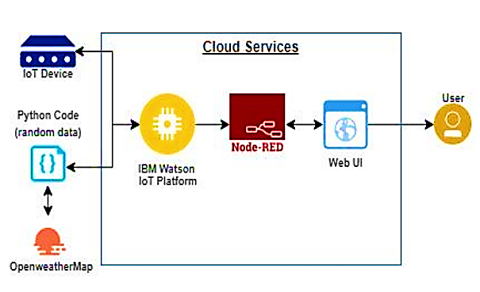
PROPOSED MODEL

Slide 10
REFERENCES
K. S. Adu-Manu, C. Tapparello, W. Heinzelman, F. A. Katsriku and J.-D. Abdulai, "Water quality monitoring using wireless sensor networks: Current trends and future research directions", ACM Trans. Sens. Netw., vol. 13, no. 1, pp. 4, 2017.
P. Salunke and J. Kate, "Advanced smart sensor interface in Internet of Things for water quality monitoring", Proc. Int. Conf. Data Manag. Anal. Innovat. (ICDMAI), pp. 298-302, 2017, 2017
S. Behmel, M. Damour, R. Ludwig and M. J. Rodriguez, "Water quality monitoring strategies—A review and future perspectives", Sci. Total Environ., vol. 571, pp. 1312-1329, Nov. 2016.
T. I. Salim, H. S. Alam, R. P. Pratama, I. A. F. Anto and A. Munandar, "Portable and online water quality monitoring system using wireless sensor network", Proc. 2nd Int. Conf. Autom. Cogn. Sci. Opt. Micro Electro Mechan. Syst. Inf. Technol. (ICACOMIT), vol. 2018, pp. 34-40, Jan. 2018.

